Slide 1
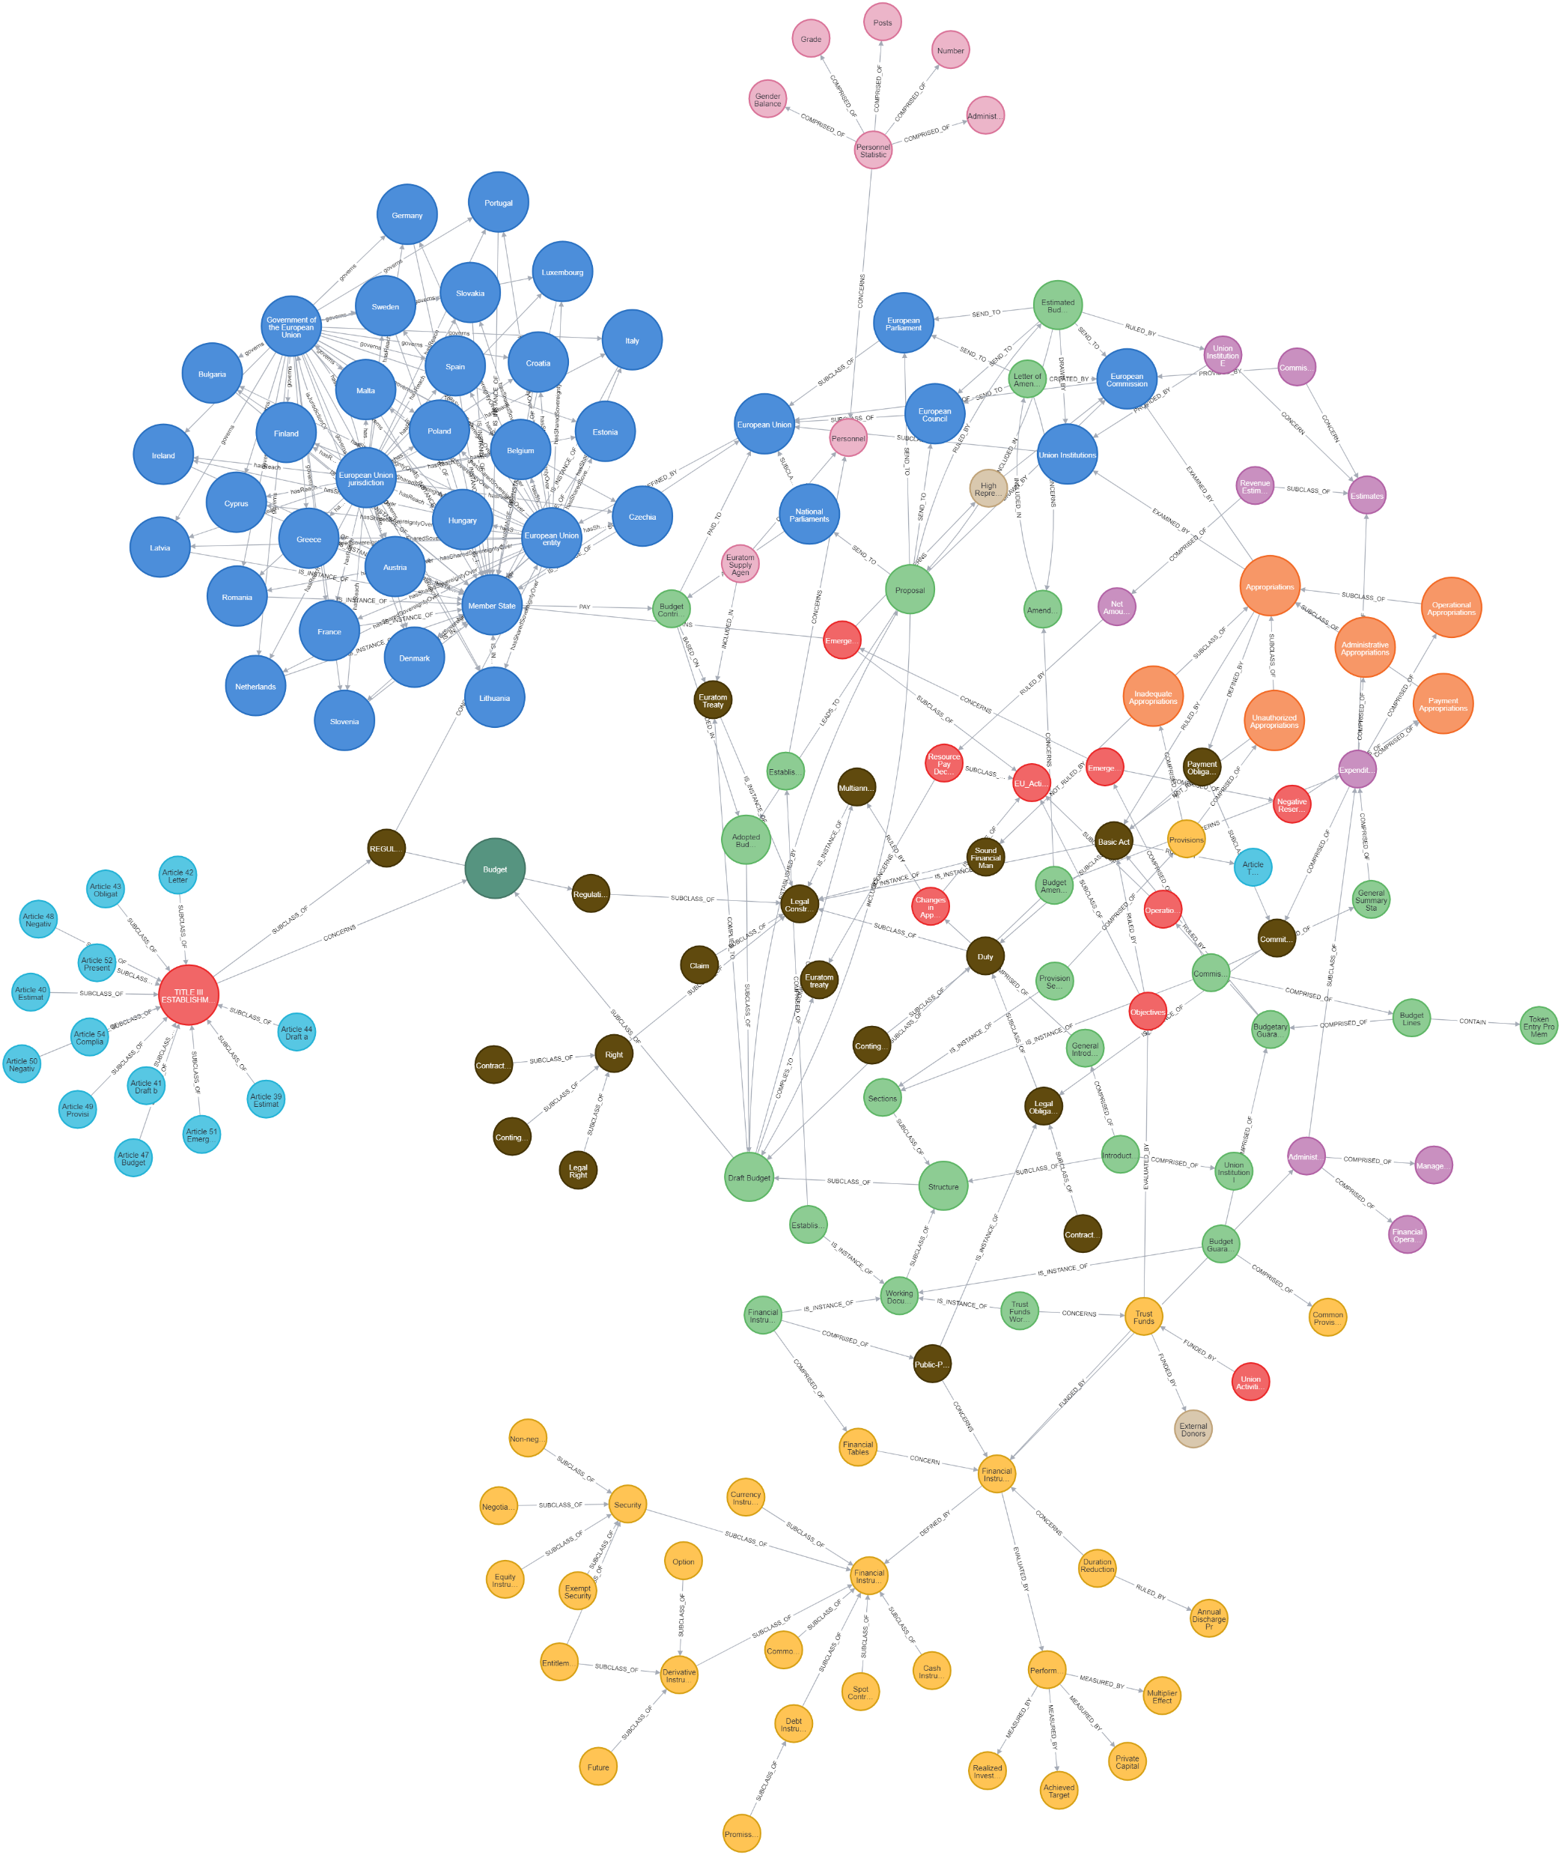
Knowledge Graph Construction of the Financial Regulations of the European Union
Supervisor
Prof. dr. Jan De Spiegeleer
Students
Ioannis Dikaioulias
Konstantinos Panagiotis Apostolou

Slide 2
What is a Knowledge Graph ?
”A graph of data intended to accumulate and convey knowledge of the real world, whose nodes represent entities of interest and whose edges represent potentially different relations between these entities.”
Hogan et al., 2021. Knowledge Graphs

Slide 3
What is a Knowledge Graph ?
“A type of graph, a structure of nodes (vertices) connected by relationships (or edges) to create high-fidelity models of a domain.”
Barrasa, J., & Webber, J. (n.d.). Building knowledge graphs.
Entity
Entity
Relationship
Node A
Node B
Edge

Slide 4
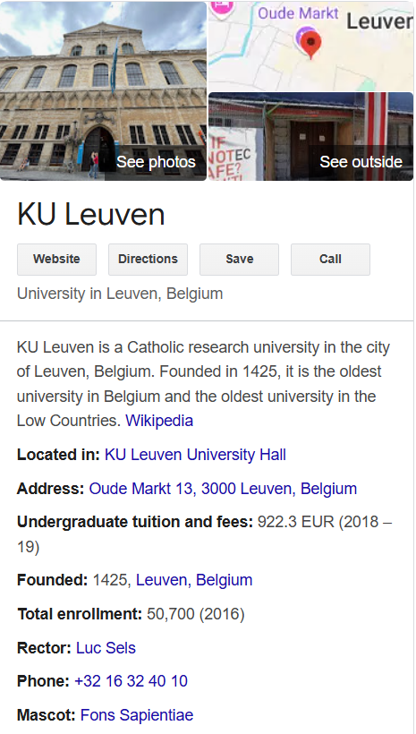
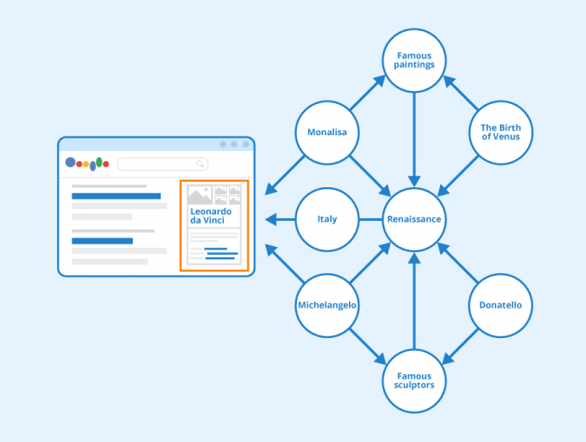
Knowledge Graphs In Everyday Life
Google Search Engine Knowledge Graph
Search Query = Transversal Through Google’s Semantic Network of Interconnected Data Points (Entities)
Final Node (Entity)
Node Properties
Figure: Google Knowledge Graph - Author: Seobility - License: CC BY-SA

Slide 5
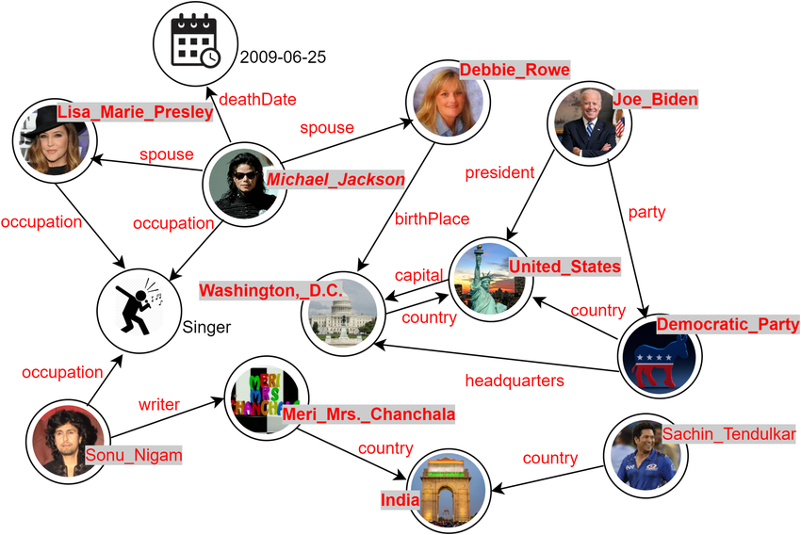
Knowledge Graph Types
DBPedia
Open-General Domain
Wikidata
DBpedia
Google Knowledge Graph
Amazon Product Graph
Close-Specific Domain / Enterprise Knowledge Graph
Fraud Detection in Banking
Cybersecurity
Flight Control Maintenance
Maritime Regulations
Logistics - Supply Chain
Banking - Fraud Detection
Financial Regulations

Slide 6
Knowledge Graph
Conveys Knowledge or Information
Is Defined and Structured based on Certain Rules
Information Extraction (IE)
Organizing Principle
Taxonomy: Allows for Simple Hierarchy Relation Among Entities
Ontology: Allows for Complex Relations Among Entities
Open IE:
Not Based on a Specific Domain – Generic IE
KG aims to answer questions of general interest (multiple domains)
Closed IE:
Domain Specific Information
KG aims to answer specific domain use case questions

Slide 7
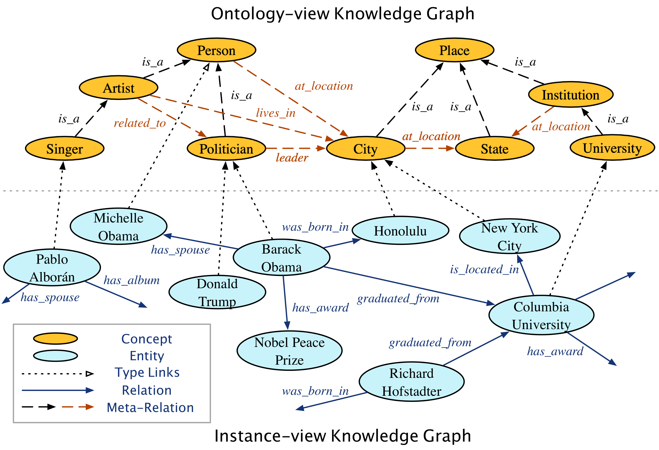
Organizing Principle: Ontology
Acts as the Schema of the Knowledge Graph
Defines the Structure of the Graph, the Hierarchy among the different Entity Classes
Is a Representation of the Semantic Relationships that exist in the graph
Acts as a Rulebook, defining the interaction that entities belonging to different classes should have with each other
Provides a Semantic Layer, that offers contextual information of each Entity

Slide 8
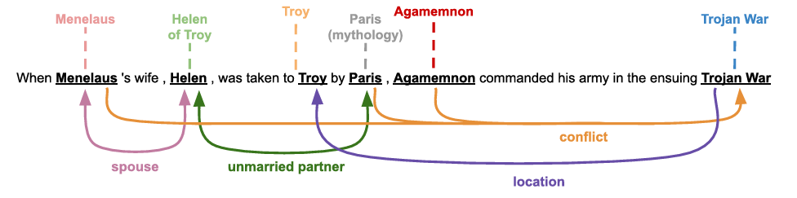
Information Extraction from Unstructured Text
Named Entity Recognition (NER)
Relation Extraction (RE)
Orlando et al. (2024). RELIK
Head – Relation – Tail
Triplet
Paris
Menelaus
Edge - Relation
Edge - Relation
Helen
Node - Entity
unmarried_partner_of
spouse_of
Node - Entity
Node - Entity

Slide 9
OpenIE
Unsupervised Learning
ClosedIE
Supervised Learning
Transfer Learning – Fine Tuning of Pretrained Methods
Transfer Learning – Direct Use of Pretrained Methods
Rule-Based IE
(ClausIE, Ollie, Standford IE)
Transformers-Based IE
(REBEL, openNRE, ReliK)
Probabilistic Models
(CRF, HMM) *Limited to NER
Deep Learning Architectures
(BERT-BiLSTM, BiLSTM, FR-BERT, R-BERT, BERT-BiLSTM-CRF)

Slide 10
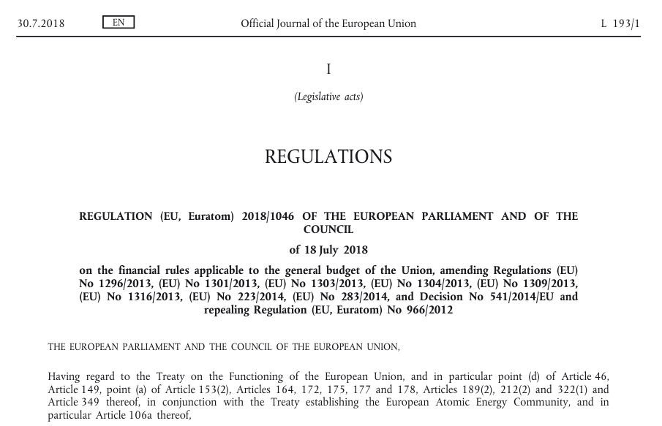
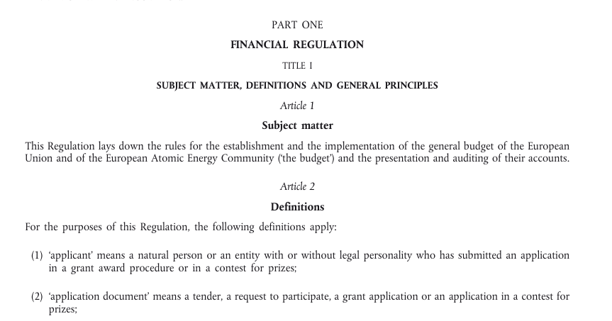
Financial Regulations of the EU
Information Extraction (IE) from Unstructured Text
GOAL:
Extract Information from Text (Triplets) and convey that information through a knowledge graph, stored in a Graph Database (Neo4j)
PROBLEMS:
Absence of a Financial Regulations Domain Ontology
Absence of Labeled Financial Regulations Domain Entity-Relation Dataset
Absence of use cases to stand as basis of the Knowledge Graph

Slide 11
Absence of Domain Use Cases
Need to Extract Use Cases
Absence of Labeled Entity-Relation Dataset
No Supervised Learning Possible
Absence of Ontology & Domain Expert
No Ontology Learning Possible
Need a Domain Schema for the Knowledge Graph
No Fine-Tuning of Pretrained Methods Possible
No Domain Expert to Create the Ontology
Problems
Preliminary Graphs
openIE Methods Utilized for Triplet Extraction
Manual Construction of Ontology-Based Schema
Solutions

Slide 12
Limit Triplets Generic Nature
Preliminary Graphs
Manual Schema Construction
Assumed Domain Expert Role
Construct Knowledge Graph Based on the Schema
Knowledge Graph Construction
Store Knowledge Graph in Neo4j Graph Database
Expand Knowledge Graph Using FIBO Ontology
Triplets Preprocessing
ClausIE openIE NLP Method for SVO Triplets Extraction

Slide 13

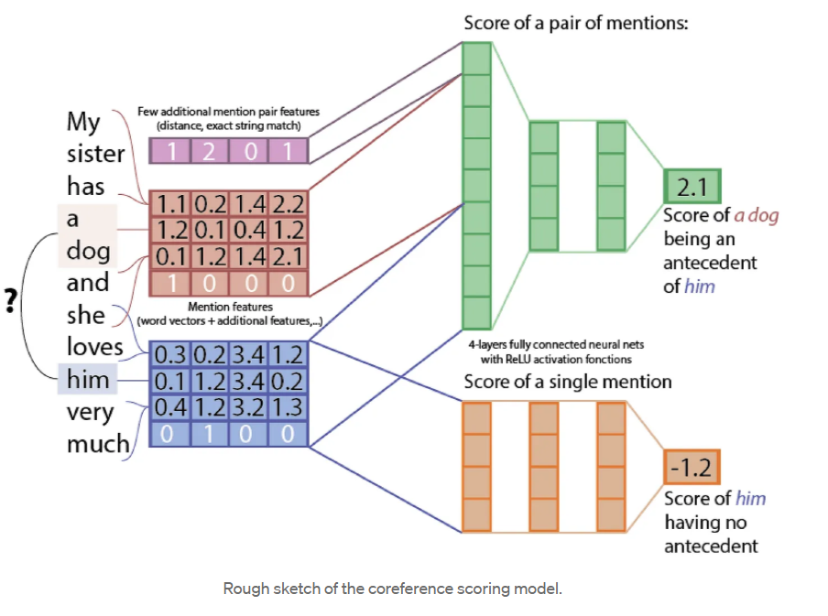
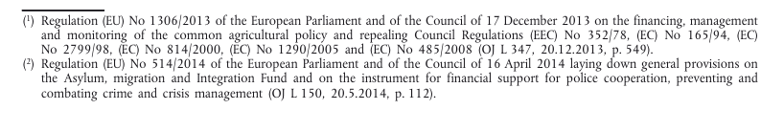
Knowledge Graph Construction Pipeline
PDF Parsing & Cleaning
PDF to TXT Conversion
Denoising
Coreference Resolution
Replace Entity References with the Entity that is Referred

Slide 14
Knowledge Graph Construction Pipeline
Head
Relation
Tail
ClausIE Implementation
Subject-Verb-Object Triplet
Rule-Based openIE
Unsupervised Method
”basic act means a legal act, other than a recommendation or an opinion, which provides a legal basis for an action and for the implementation of the corresponding expenditure entered in the budget or of the budgetary guarantee or financial assistance backed by the budget, and which may take any of the following forms”
High Number of Generic Entities
Long Tails
Difficult to Analyze Preliminary Graphs
Text Preprocessing - Sentences
Punctuation Removal
\!@#$%^&∗_–+{}\[\];\"\'\|<>,\?/~`‘’
Sentence Segmentation

Slide 15
Knowledge Graph Construction Pipeline: Limit Redundancy
Heads
Lemmatization
Relations
Lemmatization
Tails
Extract Noun Chunks of Each Tail
Stopwords Removal
Remove of Long Head Entities
Remove 2nd Token from Each Relation that are stopwords
Punctuation Removal
Clean the Noun Chunks from Stopwords and Punctuation
Extract Top Noun Chunk Using the TF-IDF Algorithm
3 Versions of Preliminary Graphs
Version A - Full Tail
Version B - Noun Chunk for Tail
Version C - Top Noun Chunk as Tail

Slide 16
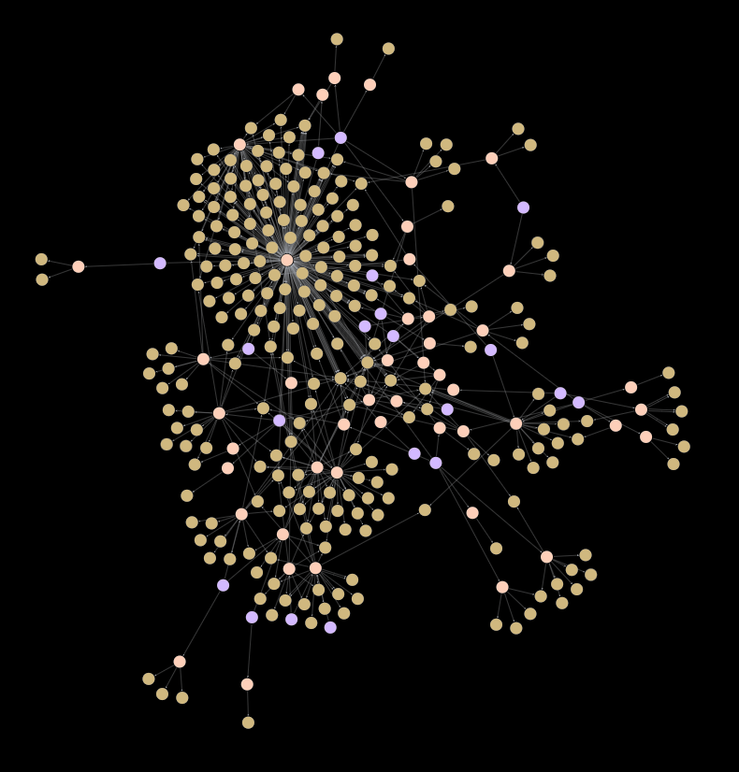
Version A Whole Tail
Limited Space for Processing (-)
Version B Expanded Tail
Lower Contextual Information (-)
Higher Contextual Information per Triplet (+)
Higher Potential for Further Preprocessing (Graph Algorithms Applications) (+)
Smaller in Size (+)
Version B: Title VII of Financial Regulations
NEED TO LIMIT THE PRELIMINARY GRAPH SIZE FOR EASIER SCHEMA CONSTRUCTION – USE CASES
Use of a Relation Frequency Threshold to create sub-graphs
Use of Centrality and Community Detection Algorithms to create sub-graphs

Slide 17
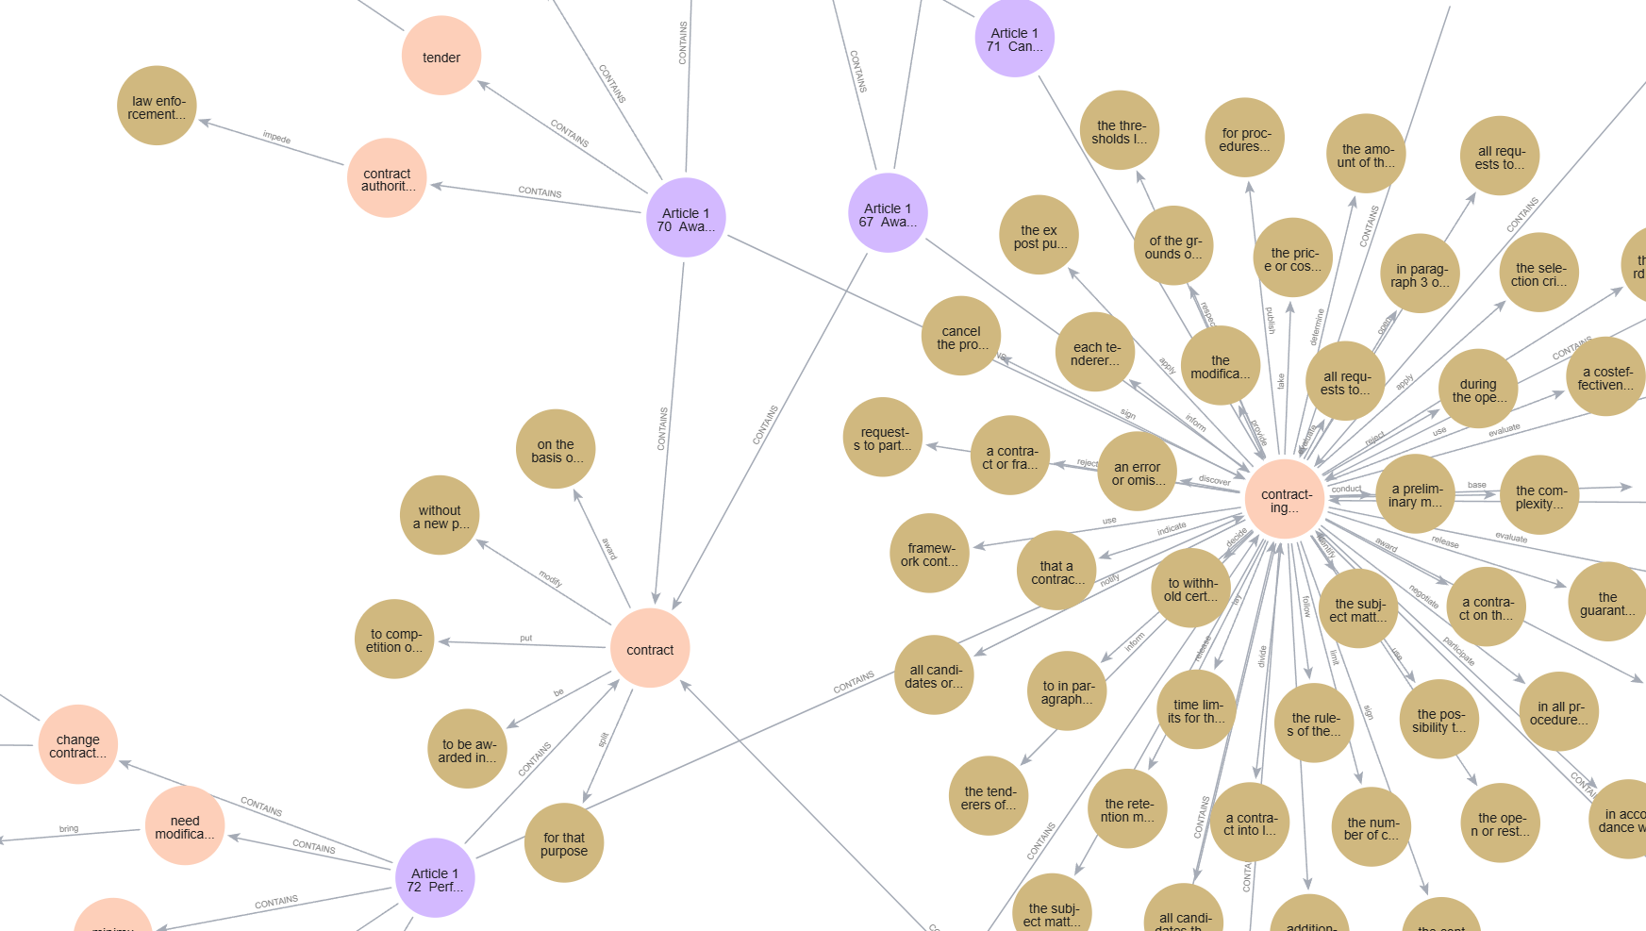
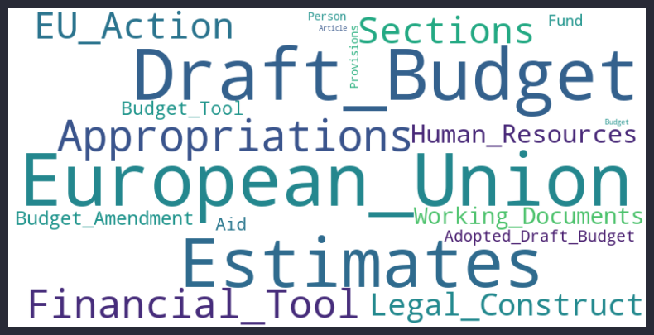
Cleaning of Entities
Ontology-Based Schema
Manual Inspection of Each Triplet
Assignment of Entities to Classes

Slide 18
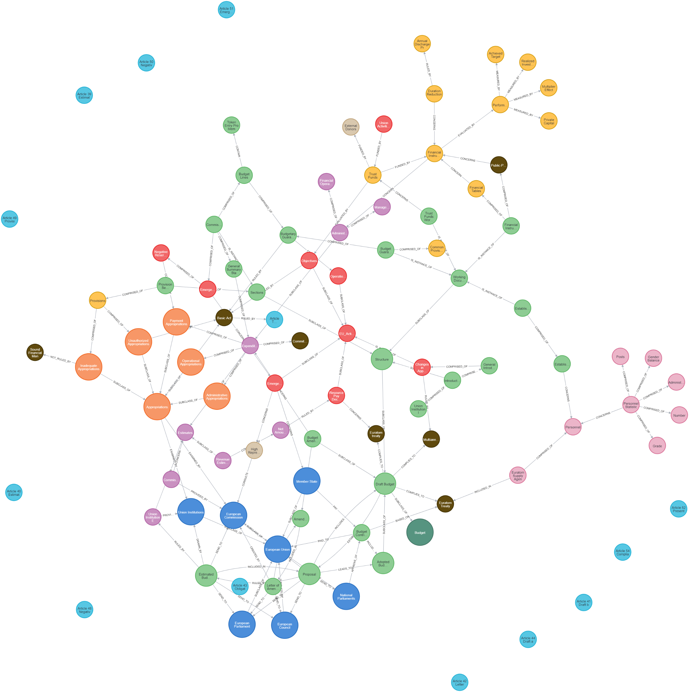

Title III: Rule-Based Knowledge Graph No FIBO
Title III: Rule-Based Knowledge Graph FIBO Connected

Slide 19
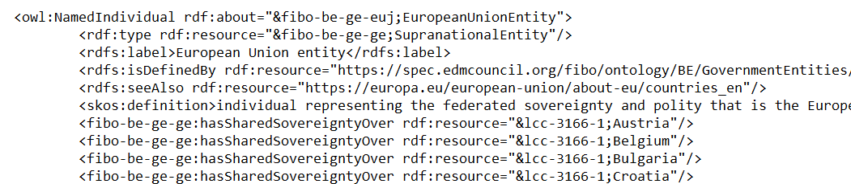
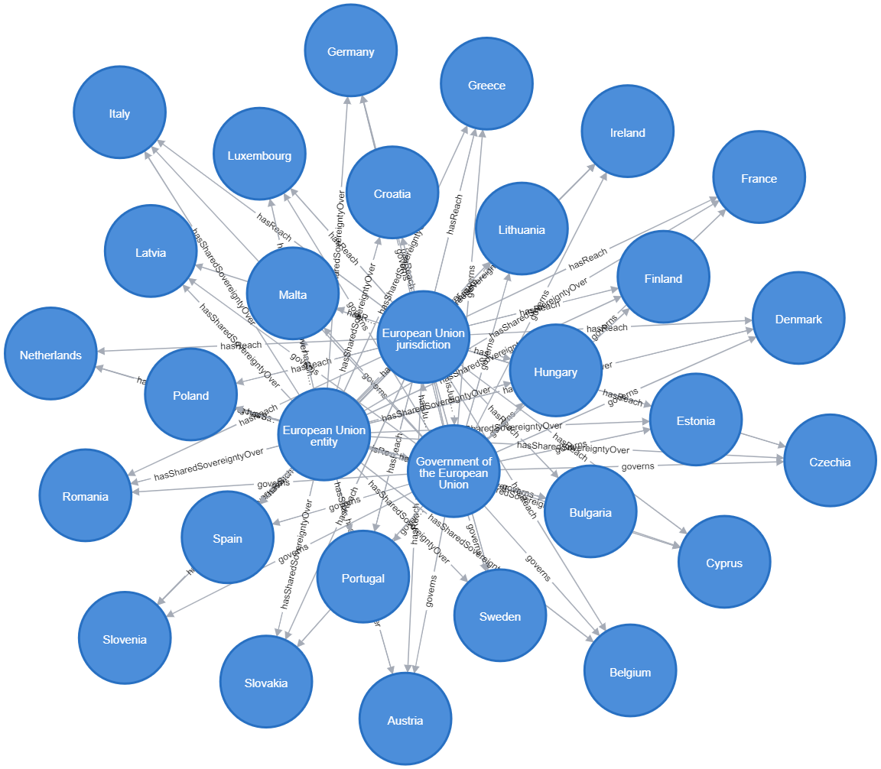

Resource Description Framework or RDF
RDF Triplets
RDF Triplets to Graph in Neo4j
Graph Triplets

Slide 20
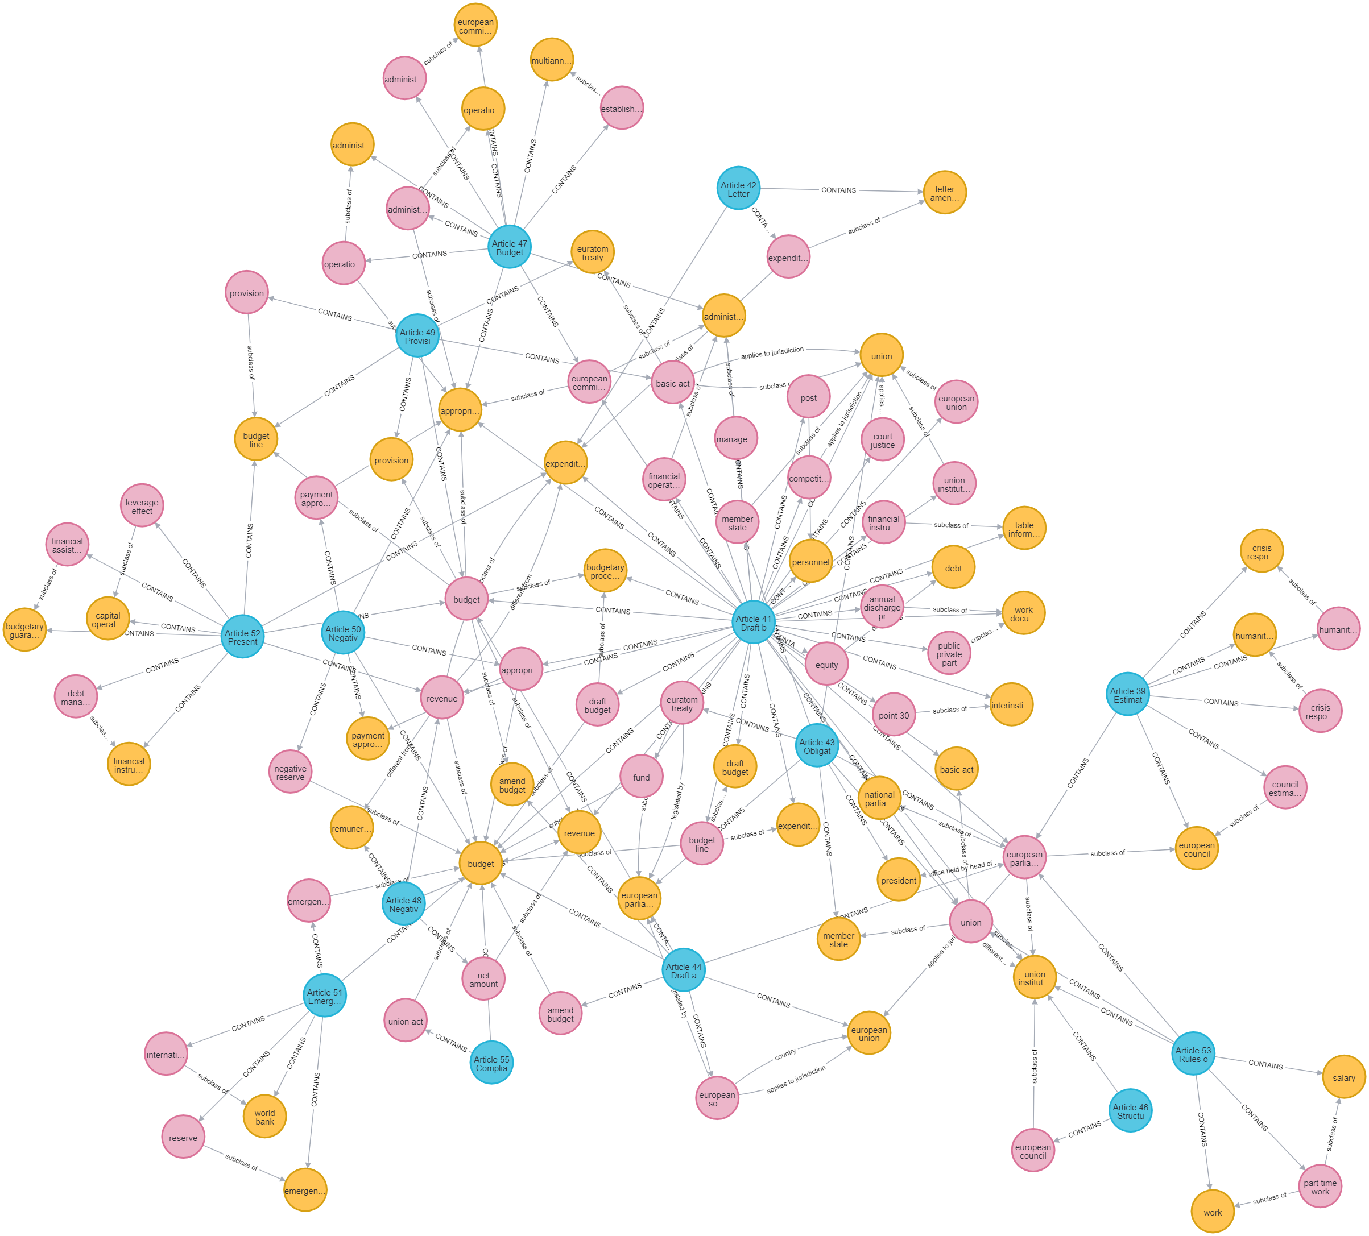
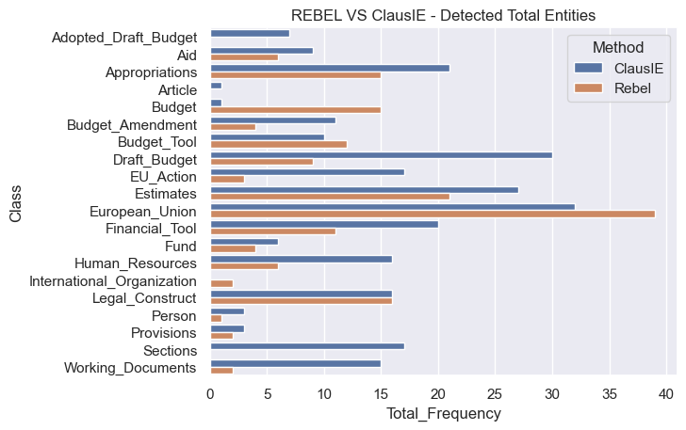
REBEL OpenIE
Input: Text Sequence Output: Triplet Sequence
Seq2seq Pretrained Model on Wikipedia Dataset
Based on BART: Transformers Encoded Decoder Model

Slide 21
Open IE
REBEL Manages To Efficiently, Produce A Similar Knowledge Graph To ClausIE
Evaluation
Open IE Methods Are Difficult To Evaluate
Evaluation Is Based On Answering Use Case Questions Through Knowledge Graph Queries
Need of Domain Expert
The Role Of The Domain Expert Was Assumed By The Student
Preliminary Graphs Are Intended To Be Analyzed By A Domain Expert
Ideal Alternatives
Train A ML Model On A Financial Regulations Entity-relation Dataset – Evaluate On Test Set
Still Human Intervention Is Required
Fine-tune A Pretrained Method – e.g. Relik, Rebel
Human Intervention Is Required To Extract The Schema

Slide 22
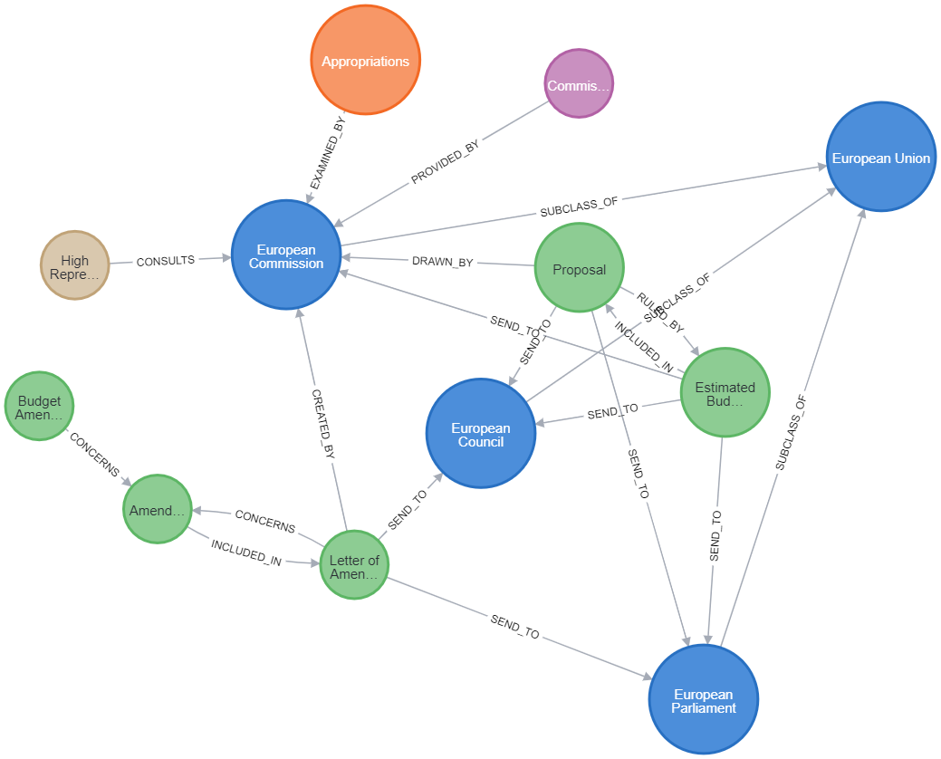
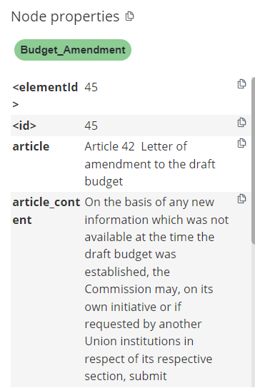
Practical Evaluation – Use Case Queries Example
MATCH (b:Budget_Amendment {name: "Letter of Amendment"})-[r]-(v)-[k]-(z)
RETURN b,r,v,k,z

